Slide 1
Movie Recommendation System
By
Rushikesh Aware
Mujahid Sayyad
Under the Guidance of
Mr . Mangesh Sir

Slide 2
Introduction
web application that suggests movies based on user preferences.
Uses advanced algorithms, user ratings, and collaborative filtering.
Enhances user experience by minimizing effort in finding relevant content.

Slide 3
Objectives
Develop an engaging web application.
Implement a scalable backend with Java & Spring Boot.
Store and manage data using SQL.
Enhance user engagement with intelligent recommendations.
Ensure seamless UI/UX with fast response times.

Slide 4
Problem Statement
With the rapid growth of digital entertainment, users have access to a vast library of movies across multiple platforms. However, finding relevant movies that align with their interests is a challenging and time-consuming task. Traditional search methods fail to provide personalized recommendations, leading to decision fatigue and a suboptimal viewing experience.
This project aims to develop a movie recommendation system that leverages both content-based filtering and collaborative filtering techniques:
Content-Based Filtering: The system analyzes movie attributes such as genres, descriptions, and keywords to recommend similar movies based on a user’s past preferences. Cosine Similarity will be used to measure the closeness between movie features.
Collaborative Filtering: The system learns from user interactions, identifying patterns and similarities among users with similar tastes. This method will use User-Based and Item-Based Collaborative Filtering to suggest movies based on collective user preferences.

Slide 5
Features
User Features:
Secure authentication & profile management.
Browse & search movies.
Rate & review movies for better recommendations.
Personalized movie suggestions.
Create & manage watchlists.
View trending & top-rated movies.

Slide 6
Tech Stack
Front end : HTML/CSS/Bootstrap/Reactjs
Backend : Spring boot & spring MVC + spring JDBC
Build Tool : maven
API Testing tool : postman
Logging tool : log4j or spring boot logging API
WEB-API : REST API using JSON
Unit test: Junit
Lombok
Version controlling tool : GIT
Database tool : MYSQL
Database : RDBMS

Slide 7
Workflow Diagram
User Registration/Login→ Profile creation & authentication.
Browse & Search → Fetch movie details using APIs.
Movie Interaction → Users rate, review, or add movies to watchlist.
Data Processing →KNN Algorithm analyze user preferences.
Personalized Recommendations → System suggests movies based on user history.

Slide 8
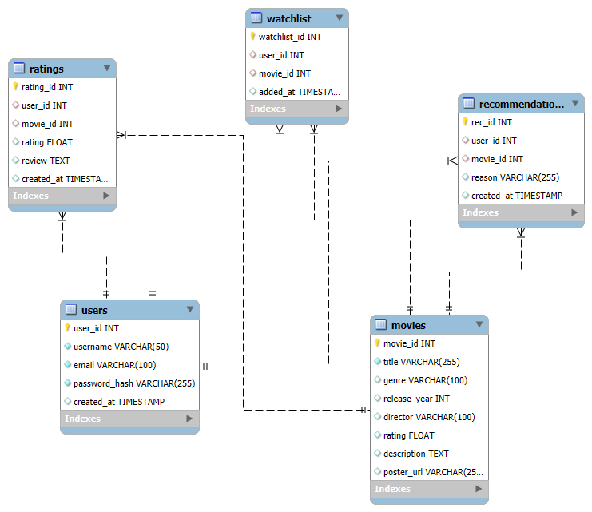

Slide 9
Expected Outcome
A user-friendly and efficient recommendation system.
personalized movie suggestions.
Scalable architecture for handling large datasets.
Integration with third-party movie databases for richer content.

Slide 10
Conclusion
Personalized Recommendations – The system enhances user experience by providing movie suggestions tailored to individual preferences.
Content-Based Filtering – Recommends movies based on attributes like genres, descriptions, and keywords using cosine similarity.
Collaborative Filtering – Suggests movies by analyzing user interactions and identifying patterns in preferences.
Hybrid Approach – Combines both methods to improve accuracy, diversity, and efficiency in recommendations.
Future improvements: Deep learning recommendations, voice search, multi-platform (mobile, smart TVs).

Slide 11
Thank You

